Slide 1
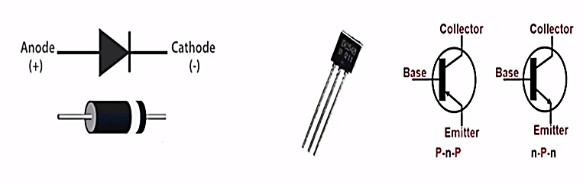
Classification of Power Semiconductor Switches
Based on number of terminals
1) Two-terminal devices
2) Three-terminal devices
Based on the degree of controllability
1) Uncontrollable switches (Diodes)
2) Semi-Controllable switches (Thyristors)
3) Fully-controllable switches (BJT, MOSFET, IGBT, GTO)

Slide 2
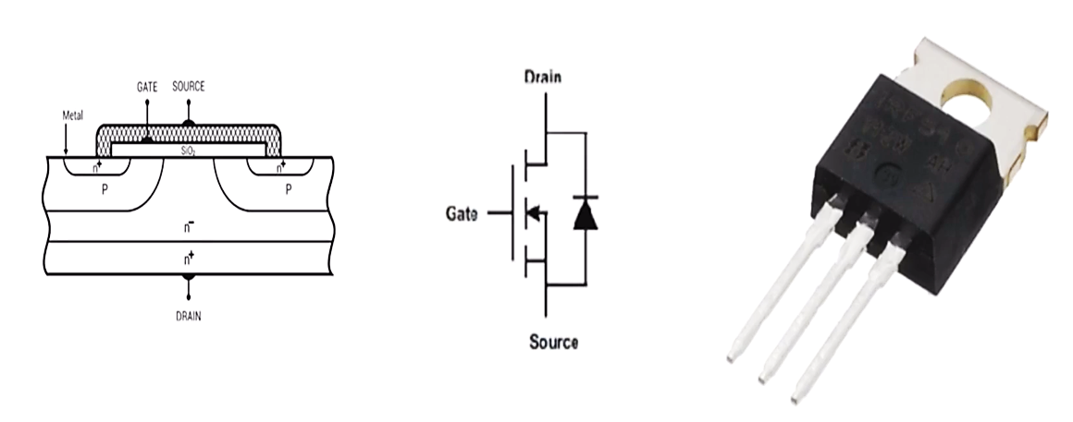
Mosfet (Metal-oxide-semiconductor Field effect transistor)

Slide 3
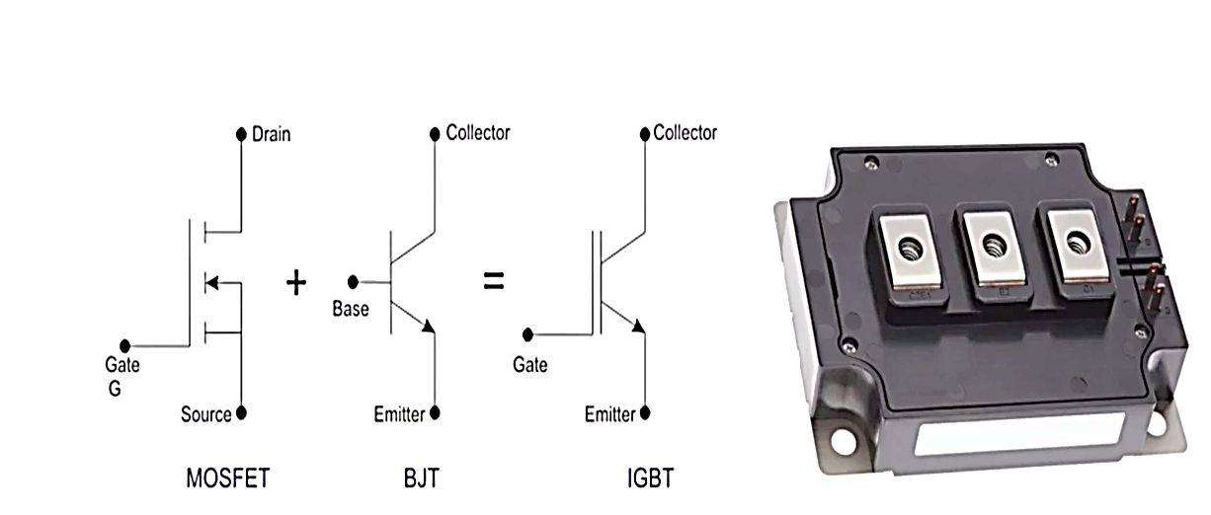
IGBT (Insulated-gate Bipolar Transistor)

Slide 4
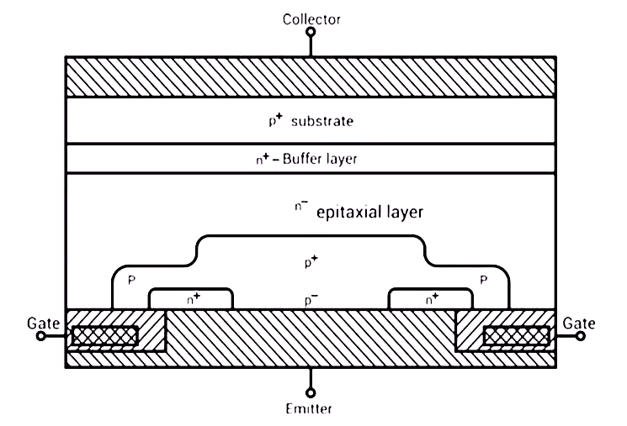
IGBT (Insulated-gate Bipolar Transistor)

Slide 5
IGBT (Insulated-Gate Bipolar Transistor)
Advantages:
Lower gate drive requirements; Low switching losses
Small snubber circuitry requirements; High input impedance
less On-state voltage drop and power loss.
Better Safe Operating Area

Slide 6
IGBT (Insulated-Gate Bipolar Transistor)
Disadvantages:
Cost
Latching-up Problem
High Turn Off time compared to MOSFET

Slide 7
Comparing the GTOs to SCRs, the GTO triumph the SCR due to their faster turn-offs, their use results in increased converter efficiency
On the side of the transistors, the IGBT which combines the advantages of the MOSFET and BJT seems to be the champion.
The MOSFET has the highest switching speeds and has the potential to be the most effective parallel switch.
Summarily, the different power electronic switching devices although compete on several levels, still possess unique characteristics that make them suitable for very uniquely specific applications.

Slide 8
Thank you

